Slide 1
Oxford Reunion October 2024 College Quiz
Last updated 5 October 2024

Slide 2
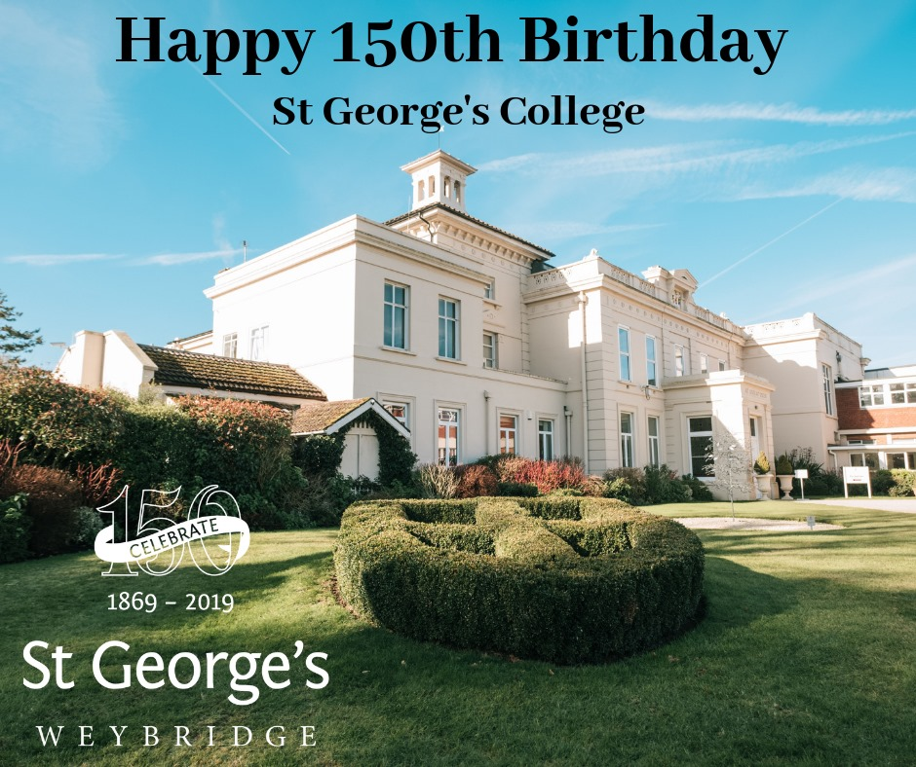
St. Georges College founded 1869, moved to Weybridge when?
Notes:
27 years
23 July 1949 – 12 July 1976
From The Georgian September 1949:
On July 23rd the Very Reverend B. Peter Murtough, C.J., B.A., was installed as President of St. George’s.
[The Headmaster was then known as President. Title changed to Headmaster in 1964.]

Slide 3
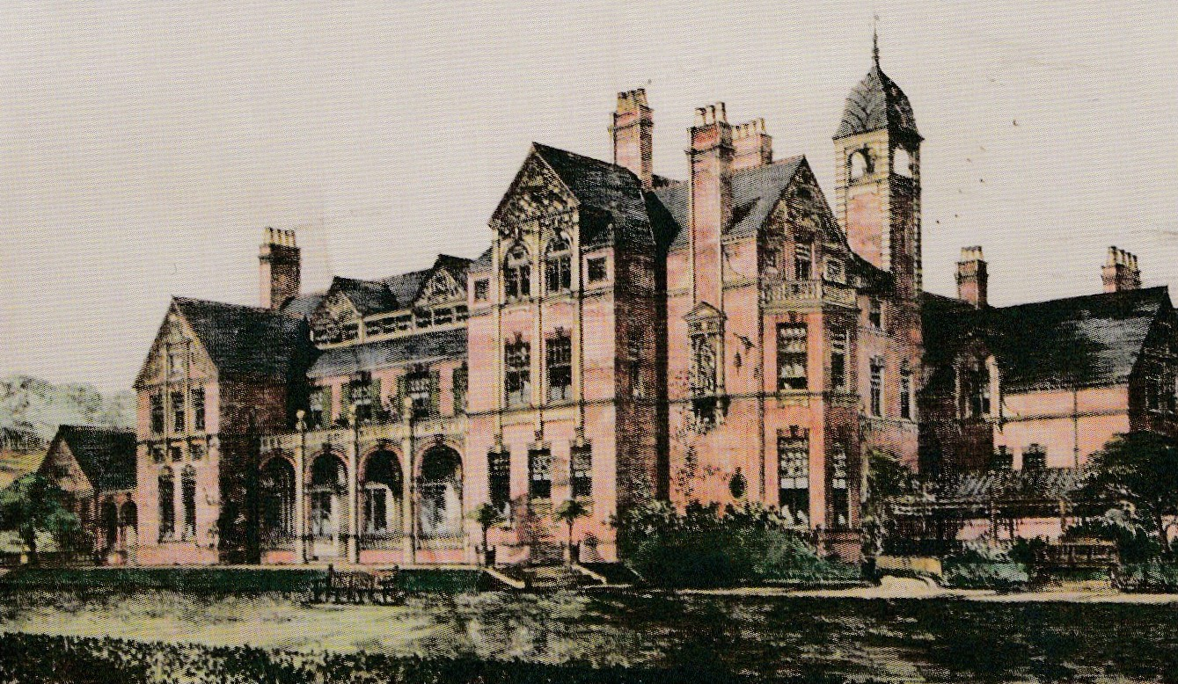
Who built the old Red House?
Notes:
27 years
23 July 1949 – 12 July 1976
From The Georgian September 1949:
On July 23rd the Very Reverend B. Peter Murtough, C.J., B.A., was installed as President of St. George’s.
[The Headmaster was then known as President. Title changed to Headmaster in 1964.]

Slide 4
What is the architectural style?
Notes:
27 years
23 July 1949 – 12 July 1976
From The Georgian September 1949:
On July 23rd the Very Reverend B. Peter Murtough, C.J., B.A., was installed as President of St. George’s.
[The Headmaster was then known as President. Title changed to Headmaster in 1964.]

Slide 5
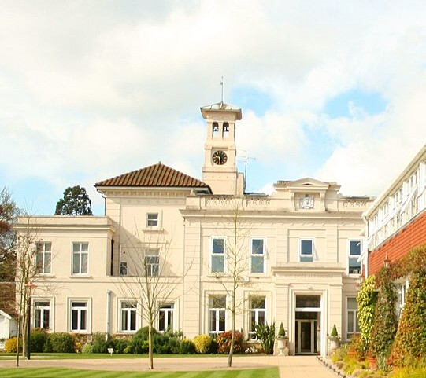
What is the architectural style?
Notes:
27 years
23 July 1949 – 12 July 1976
From The Georgian September 1949:
On July 23rd the Very Reverend B. Peter Murtough, C.J., B.A., was installed as President of St. George’s.
[The Headmaster was then known as President. Title changed to Headmaster in 1964.]

Slide 6
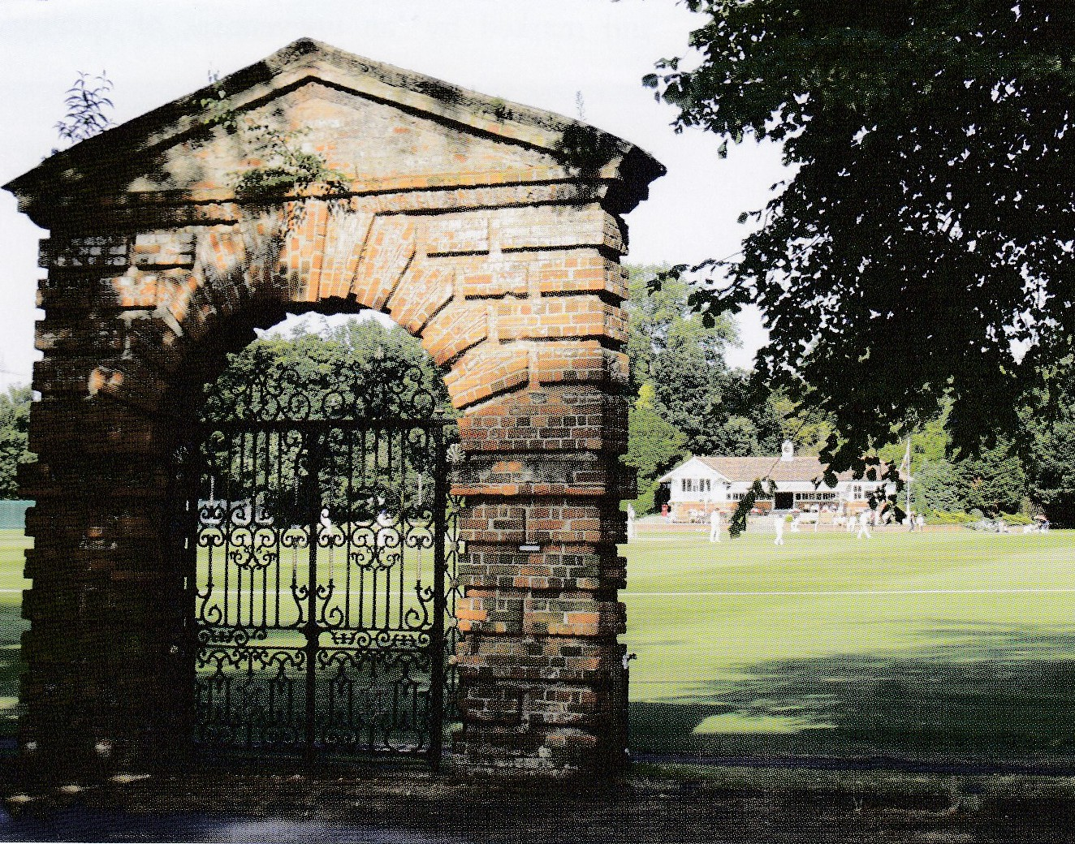
Arch named after who?
Notes:
27 years
23 July 1949 – 12 July 1976
From The Georgian September 1949:
On July 23rd the Very Reverend B. Peter Murtough, C.J., B.A., was installed as President of St. George’s.
[The Headmaster was then known as President. Title changed to Headmaster in 1964.]

Slide 7
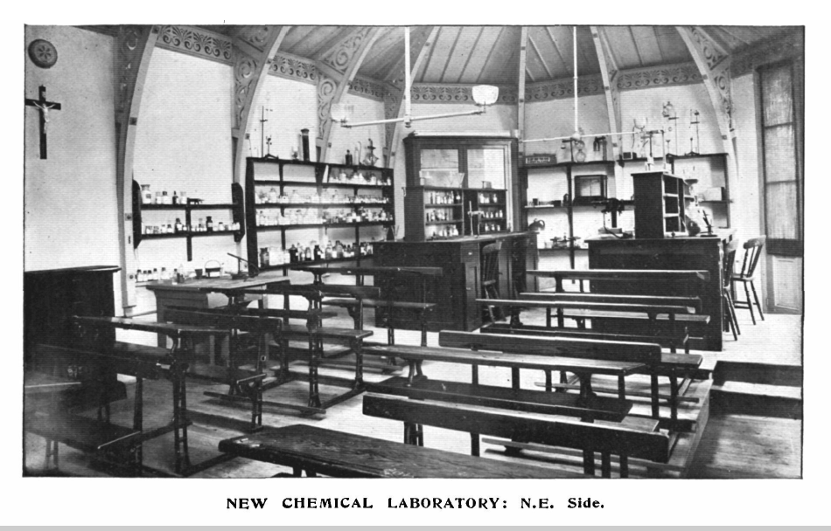
1907-1958 Where?
Notes:
27 years
23 July 1949 – 12 July 1976
From The Georgian September 1949:
On July 23rd the Very Reverend B. Peter Murtough, C.J., B.A., was installed as President of St. George’s.
[The Headmaster was then known as President. Title changed to Headmaster in 1964.]

Slide 8
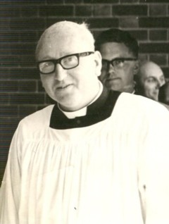
Fr. Peter had the longest tenure as headmaster. For how many years?
Notes:
27 years
23 July 1949 – 12 July 1976
From The Georgian September 1949:
On July 23rd the Very Reverend B. Peter Murtough, C.J., B.A., was installed as President of St. George’s.
[The Headmaster was then known as President. Title changed to Headmaster in 1964.]

Slide 9
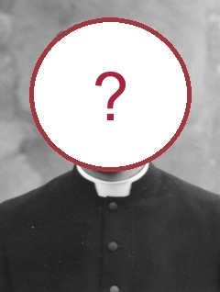
Which headmaster had the shortest tenure?
Notes:
Nine months
September 1976 – May 1977
Catholic Herald 27 May 1977
The headmaster of St George's College, Weybridge, Fr Illtyd Morgan Evans has resigned and is seeking laicisation.
The announcement was made in a letter to parents from Fr Peter Murtough, Chairman of the Board of Governors and former headmaster. He said that it was with profound regret and great personal sadness that he had to tell the parents this and he asked for their prayers at this difficult time.
The Georgian June 1977
We are very sorry to record that Fr Illtyd Morgan Evans has resigned as
Headmaster of St George's College and has asked permission from Rome to
continue life in the lay state.

Slide 10
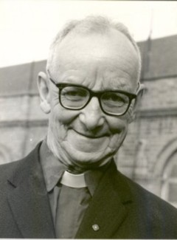
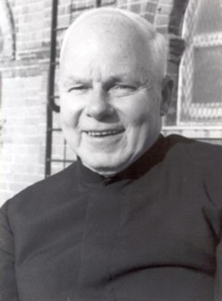
Brother Vincent and Brother Joseph had what connection?
Notes:
Nine months
September 1976 – May 1977
Catholic Herald 27 May 1977
The headmaster of St George's College, Weybridge, Fr Illtyd Morgan Evans has resigned and is seeking laicisation.
The announcement was made in a letter to parents from Fr Peter Murtough, Chairman of the Board of Governors and former headmaster. He said that it was with profound regret and great personal sadness that he had to tell the parents this and he asked for their prayers at this difficult time.
The Georgian June 1977
We are very sorry to record that Fr Illtyd Morgan Evans has resigned as
Headmaster of St George's College and has asked permission from Rome to
continue life in the lay state.

Slide 11
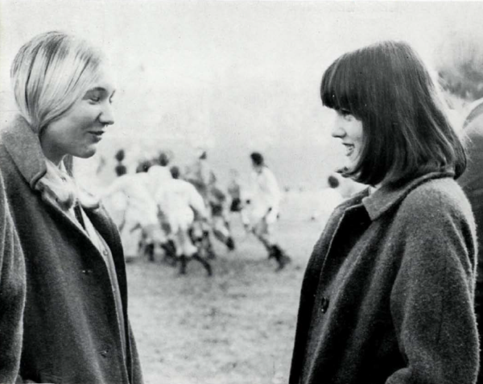
Who were the cover girls on the 1968 Georgian?
Notes:
Nine months
September 1976 – May 1977
Catholic Herald 27 May 1977
The headmaster of St George's College, Weybridge, Fr Illtyd Morgan Evans has resigned and is seeking laicisation.
The announcement was made in a letter to parents from Fr Peter Murtough, Chairman of the Board of Governors and former headmaster. He said that it was with profound regret and great personal sadness that he had to tell the parents this and he asked for their prayers at this difficult time.
The Georgian June 1977
We are very sorry to record that Fr Illtyd Morgan Evans has resigned as
Headmaster of St George's College and has asked permission from Rome to
continue life in the lay state.

Slide 12
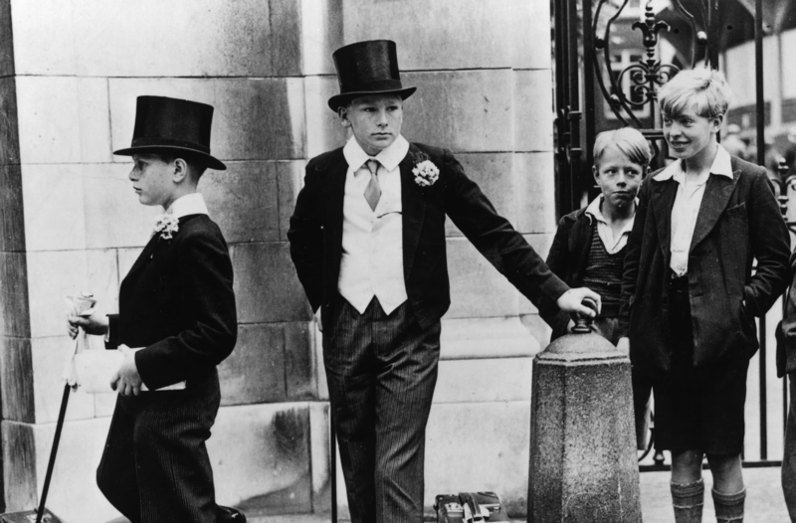
When did the College become a Public School?
Notes:
Nine months
September 1976 – May 1977
Catholic Herald 27 May 1977
The headmaster of St George's College, Weybridge, Fr Illtyd Morgan Evans has resigned and is seeking laicisation.
The announcement was made in a letter to parents from Fr Peter Murtough, Chairman of the Board of Governors and former headmaster. He said that it was with profound regret and great personal sadness that he had to tell the parents this and he asked for their prayers at this difficult time.
The Georgian June 1977
We are very sorry to record that Fr Illtyd Morgan Evans has resigned as
Headmaster of St George's College and has asked permission from Rome to
continue life in the lay state.

Slide 13
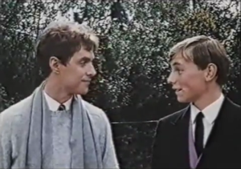
Had a leading part in 1968 feature film. * Name of film? * Author of novel of same title?
Notes:
Nine months
September 1976 – May 1977
Catholic Herald 27 May 1977
The headmaster of St George's College, Weybridge, Fr Illtyd Morgan Evans has resigned and is seeking laicisation.
The announcement was made in a letter to parents from Fr Peter Murtough, Chairman of the Board of Governors and former headmaster. He said that it was with profound regret and great personal sadness that he had to tell the parents this and he asked for their prayers at this difficult time.
The Georgian June 1977
We are very sorry to record that Fr Illtyd Morgan Evans has resigned as
Headmaster of St George's College and has asked permission from Rome to
continue life in the lay state.

Slide 14
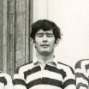
Brendan Moore’s younger brother Richard (OG ‘81) does what for a living?
Notes:
Richard Moore (OG 1981) is head of MI6
The Georgian January 1970
Brendan Moore joined the Noviciate in September 1969

Slide 15
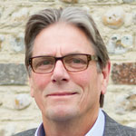
Anthony Wickins’ father and uncle (both OGs) did what for a living?
Notes:
Uncle David Wickins founded British Car Auctions in 1946
He was married at least three times, and possibly (though his own account varied) six. (Obituary)
The Georgian January 1954
David Wickins ('36) has taken over a large hall at Alexandra Palace for car auctions; he has also installed buffets, rest rooms and a boating lake for children.
Father John Wickins was also a director of BCA

Slide 16
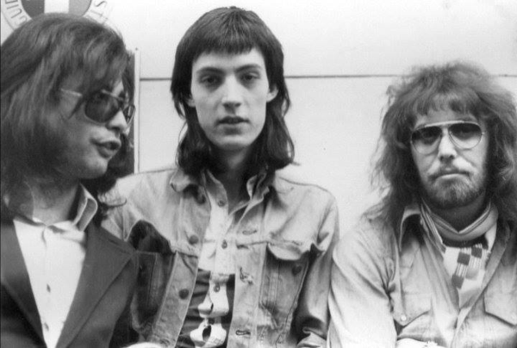
Ric Parnell was drummer in which band in 1972-74?
Notes:
Atomic Rooster
Group split in 1974

